Slide 1

Deliverable 3
Process Modeling
IS 436

Slide 2
Who Are We?
Muhammad Hamza - Project Manager
Siril Pattammady - Systems Developer
Josh Johnson - Systems Analyst
Khadija Shafiq - Business Analyst
Jay Patel - Network Engineer
Shaikha Al Shamsi - Requirement Analyst

Slide 3


Process Models
Visio
Lucid Charts
Develop Process Model
Context Level Diagrams

Slide 4
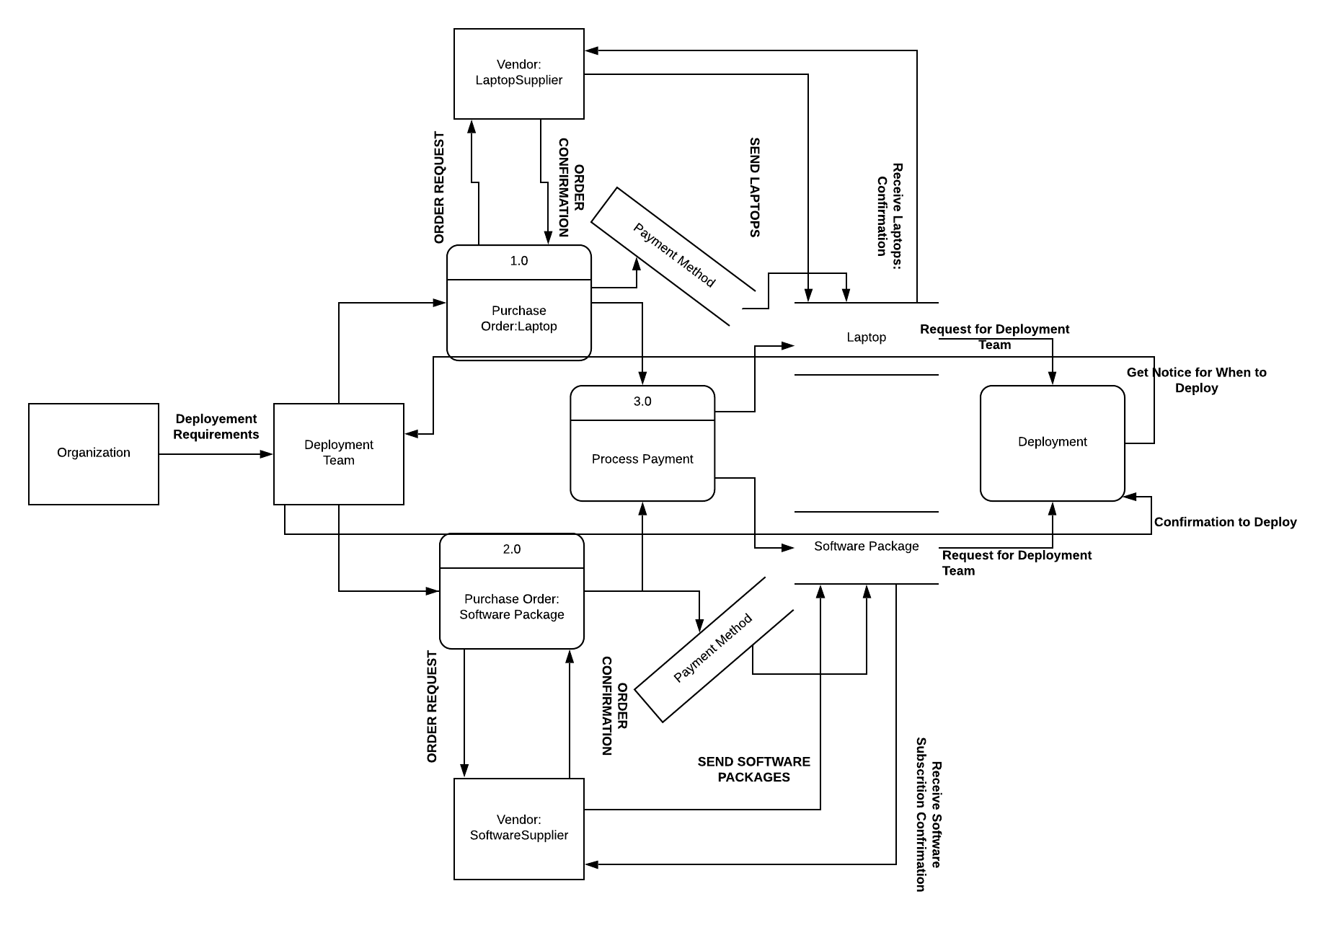
Data Flow Diagram

Slide 5
Functional Requirement
Process-Oriented
The system shall allow new laptop deployment
The system shall allow new users to merge with new domain
The system shall allow new IOT devices to be connected
The system shall allow request from end users for changes that are needed
The system shall allow different departments to be interconnected
The system shall be assigned to an order to cash ERP System
The system shall allow analyst and developers to make changes.
The system shall be allowed to log existing data.
The system shall have recovery measures for any potential outage.

Slide 6
Non-Functional Requirement
Operational/Performance
The system should be readily available for users and workers
The system should be manageable by analysts and developers
The system should be secure and recoverable for potential incident
The system should be maintainable after transition from merger
The system should be fairly reliable after all upgrades.
The system should improve productivity and service as ‘old’ system is removed and upgraded.
The system should allow users to login or create new login and password
The system should allow analysts and developers to make changes
The system should allow portability and universal software/OS to be uploaded throughout devices.

Slide 7
Non-Functional Requirement
Security
The system should uphold data integrity
The system should implement firewalls and protection throughout devices
The system should ensure customer information is protected following HIPAA standards.
Cultural and Political
The system should ensure personal and customer information is protected under law and HIPAA compliant.
The merger should allow both companies to work together and become one company.
Should allow company standards and ethical workplace behaviour.

Slide 8
USE CASES
Use Case# 1 Deployment Laptops Priority: High
Use Case# 2 Conversion from QAD to SAP Priority: High
Use Case# 3 Uploading Software on Devices Priority: High

Slide 9
High Level Process
Laptop Deployment
With regards to laptop deployment, the initial step would be procurement. Upon the successful acquisition of the specified laptop devices, the next step would be to allocate the laptops to target individuals in order to load necessary programs and applications. The exact programs that would need to be necessary for each department may vary, although this process can occur on an ongoing basis. To complete this process, the laptops will be ‘tagged’ and assigned to target individuals and integrated into the company’s systems.

Slide 10
High Level Process
Software Implementation
The software implementation should be fairly simple to accomplish. This would include determining which particular software should be implemented on the said laptops in order to allow off-prem work to be completed remotely. A VPN would be required in order to provide a secure tunnel between the staff members’ home networks straight to the company’s internal network. After all software implementations have been made, the laptops can be assigned to staff members and physically distributed.

Slide 11
High Level Process
Conversion from QAD to SAP
The biggest segment to this project would be the conversion process from the QAD ERP software to the SAP software. This would include creating backups for all data sets in order to ensure redundancy and to verify the integrity of all current data. With regards to financial security, it’s imperative to ensure that the newly transitioned data sets are accurate and verified. Any anomalies will require special attention in order to acknowledge any faults or errors that were encountered. In the case of a successful conversion, a simple double check would allow us to acknowledge the completion of the process.

Slide 12
Definition for Laptop Deployment
Organization: Merger between Osiris and Smith & Nephew Company. Defined to show the high level commands/requirements that are needed for the merger for deployment.
Deployment Team: Follows rules from the organization based on requirements and what is needed for a successful deployment. Focused on deploying laptops with software packages.
Vendors: Vendors that provide the resources for organizations successful deployment such as laptops and software packages.
Process - Purchase Order: Laptop :Request to purchase laptops for organization through vendor.
Process- Purchase Order:Software Package: Request to purchase software subscription and packages through vendor
Process Payment: Handles transaction between vendor and organizations deployment team by taking form of payment and order confirmation based on request. Vendor sends item and waits for delivery confirmation
Process Deployment: Waits till all process are done, sends a request to deployment team for them to decide if deployment is ready. When ready deployment is underway.
DataStore: Laptop, Software Package, Payment method all stored and recorded for deployment team to decide if deployment is ready.

Slide 13
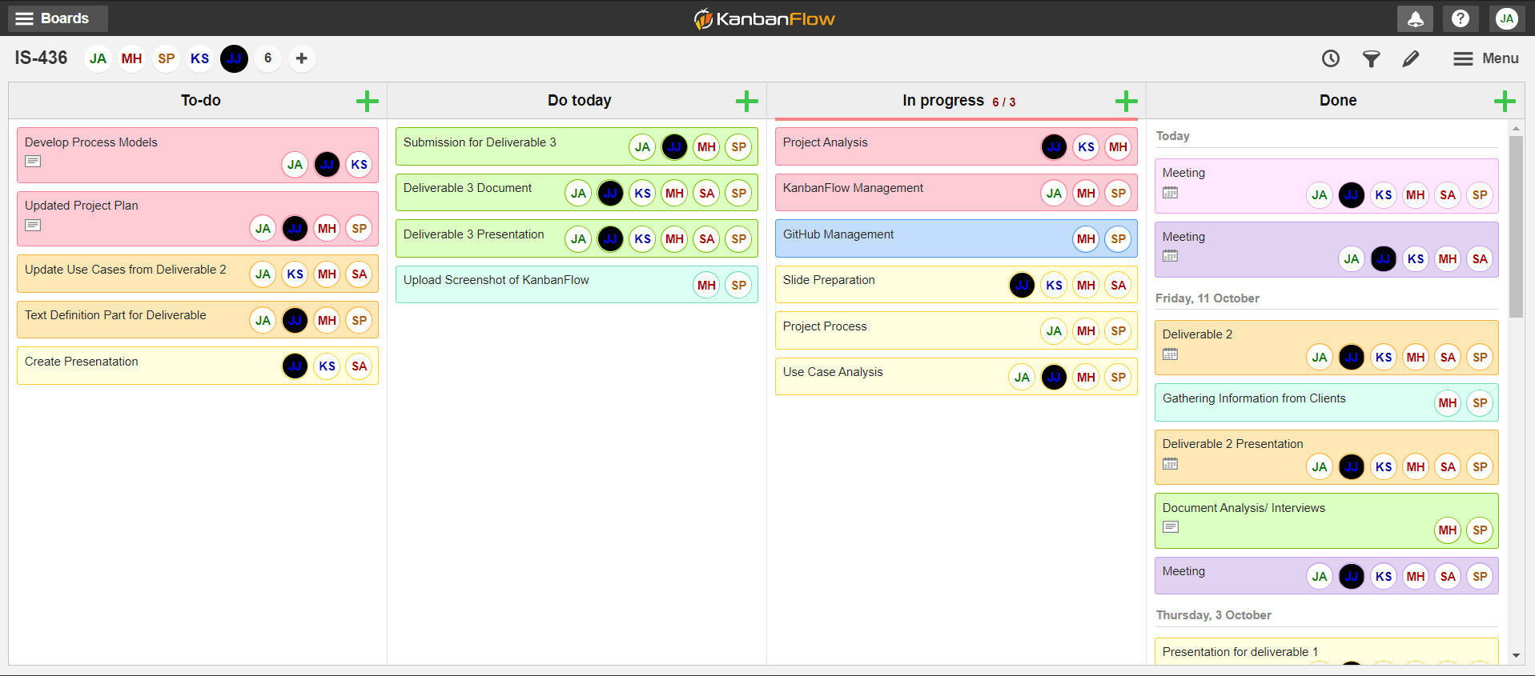
KanbanFlow

